Slide 1
Meeting Week 8
Last week summary
  Discussed research plan
Simulation FP baseline
  Frozen LTI
  LPV-DT
  Feedforward
Outline ToDo next week

Slide 2
Where in the process?
Before augmentation adjust FP model
  Jasper provided in MATLAB model of the dual-gantry system based on the García paper
    Needs to be converted to Python to work with Jan’s augmentation code
    Needs to be adjusted to LPV format. Currently already has Y scheduling in the mass matrix M(Y)
    Needs to be converted to Discrete Time to work with augmentation code
      Augmentation framework in discrete time (needs to be able to do next-state mapping (x_{k+1}))

Slide 3
MATLAB model – García paper
Equations of Motion of Simplified Dual-Drive Gantry Stage (H-Type)
  Simplified Equations of Motion:
    M ddq + C dq + K q = f
  Logical cooridinates derived from stage coordinates (X1, X2, Y):
    q = [X, Theta, Y]^T

Slide 4
Generalized coordinates | What it is | M(Y) updating | Coriolis | Coulomb
q | Full physical simulation (Simscape): masses, joints, actuators and friction elements connected as a network. All nonlinear effects are included automatically, no manual simplification. | Yes | Yes | Yes
q1 | Simplified math model: equations of motion solved continuously by ode45, inertia M(Y) updated at every integration step, velocity-dependent nonlinear terms (Coriolis) not included | Yes | No | No
q2 | Same as q1 but with the Coriolis terms included | Yes | Yes | No
q3 | Frozen linear model: inertia fixed at Y = 0.3 m, stepped forward one sample at a time at 16 kHz, never updates with Y | No | No | No

Slide 5
Frozen LTI baseline – Python Implementation
Translated the MATLAB first-principles model into Python as a discrete-time state-space model.
  The inertia matrix M is evaluated once at the design operating point Y = 0.3 m and held constant; Frozen LTI baseline.
Compared it to:
  q3 (MATLAB lsim): the same frozen linear model run in MATLAB.
    Confirmation that Python translation is numerically identical to the MATLAB
  q (Simscape): the full nonlinear physical simulation including Y-varying inertia, Coriolis, and Coulomb friction. Used as ground truth
    Identification of gap between linear and nonlinear model

Slide 6
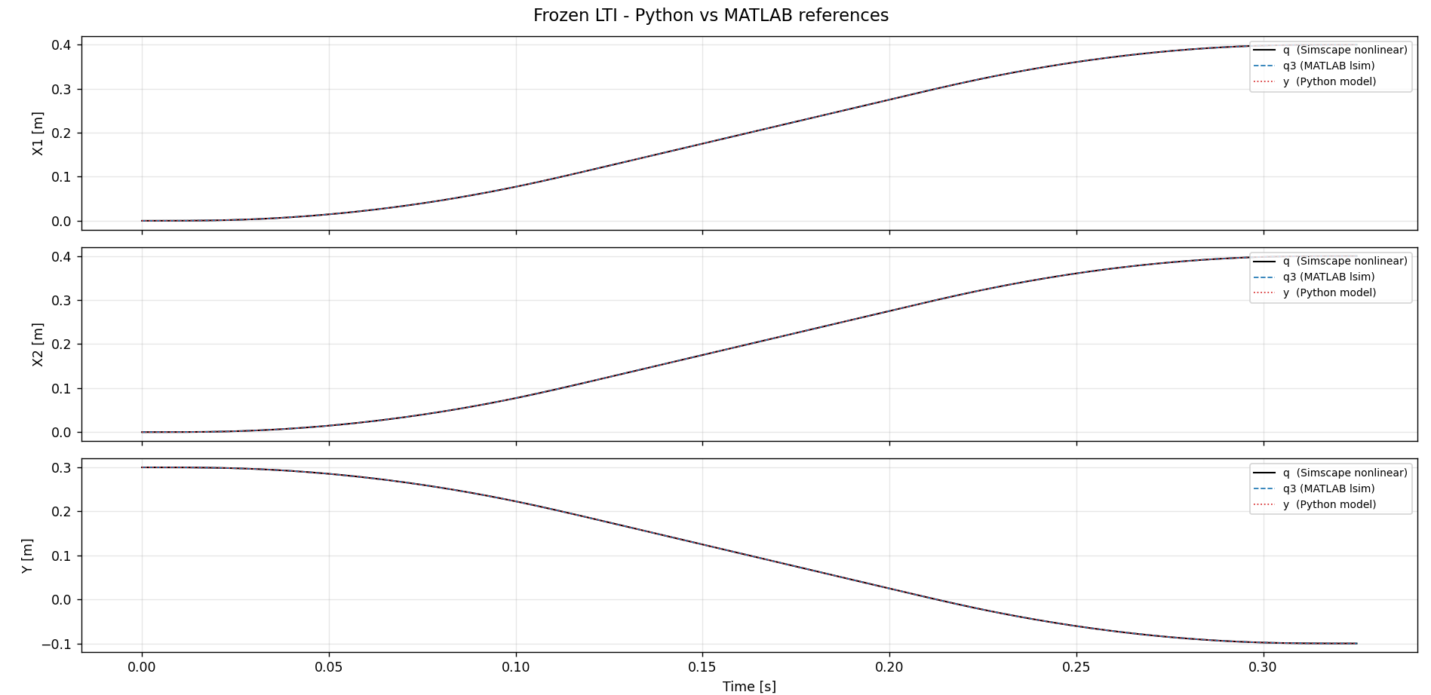

Slide 7
Frozen LTI baseline – Python implementation
Residuals (RMS and max absolute, in m):
y vs q3 [implementation check]:
X1 RMS=1.10e-13 m max=2.26e-13 m
X2 RMS=1.28e-13 m max=2.57e-13 m
Y RMS=7.46e-14 m max=1.24e-13 m
q3 vs q [linearisation gap] :
X1 RMS=4.86e-06 m max=1.62e-05 m
X2 RMS=3.19e-06 m max=1.11e-05 m
Y RMS=9.80e-08 m max=3.98e-07 m
y vs q [total error] :
X1 RMS=4.86e-06 m max=1.62e-05 m
X2 RMS=3.19e-06 m max=1.11e-05 m
Y RMS=9.80e-08 m max=3.98e-07 m

Slide 8
LPV-DT
Initial plan:
  Pre-discretize the LPV model using Tóth's ZOH method before training
  Feedback TU/e: CT+RK4 is more accurate
Tóth static dependence: only reasonable for LPV-SS with static dependence, scheduling variable Y is a system state, not an exogenous signal (quasi-LPV)
  Within each sample interval, Y evolves continuously; not fully held constant by ZOH
CT + RK4 is more accurate: instead of pre-discretizing, we integrate the continuous-time ODE with RK4 at each timestep rrr
  Re-evaluates M(Y) at each sub-step as Y evolves, avoiding the intra-sample approximation error
Notes:
So the errorless property does not strictly apply.

Slide 9
LPV-DT
Initial plan:
  Pre-discretize the LPV model using Tóth's ZOH method before training
  Feedback TU/e: CT+RK4 is more accurate
Tóth static dependence: only reasonable for LPV-SS with static dependence, scheduling variable Y is a system state, not an exogenous signal (quasi-LPV)
  Within each sample interval, Y evolves continuously; not fully held constant by ZOH
CT + RK4 is more accurate: instead of pre-discretizing, we integrate the continuous-time ODE with RK4 at each timestep
  Re-evaluates M(Y) at each sub-step as Y evolves, avoiding the intra-sample approximation error
  RK4 over ODE45, because sample time is consistent: needed to convert to DT model
Notes:
So the errorless property does not strictly apply.

Slide 10
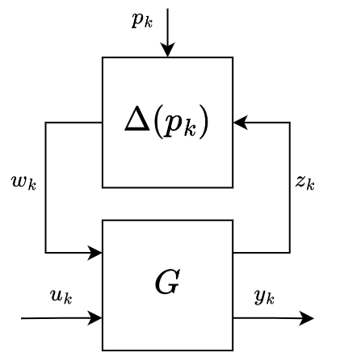
LPV-LFR – Why LFR?
M(Y)⁻¹ has rational entries in Y → affine LPV-SS is insufficient
LFR isolates all Y-dependence in a single scheduling block Δ(Y)
G^b remains constant only Δ(Y) varies with Y
Enables Drenth augmentation framework directly
Notes:
What "rational entries in Y" means:
M(Y) is a polynomial in Y (entries have Y and Y² terms). When you invert it, M(Y)⁻¹ = adj(M(Y)) / det(M(Y))
so every entry becomes a fraction: a polynomial divided by a polynomial. That's what "rational" means.
For example, one entry might look like:
$$\frac{a_0 + a_1 Y + a_2 Y^2}{b_0 + b_1 Y + b_2 Y^2}$$
What "affine LPV-SS is insufficient" means:
An affine LPV model has the form:
$$A(Y) = A_0 + Y \cdot A_1$$
linear in Y, no fractions. You can't write a fraction exactly as a polynomial. So affine LPV-SS cannot
exactly represent A_c(Y) = [[-M(Y)⁻¹K, -M(Y)⁻¹C], ...].
Why LFR solves this:
LFR can represent rational dependence exactly by putting Y in a feedback loop with a constant matrix G^b.
The feedback structure naturally produces fractions, just like (I - D_zw·Δ)⁻¹ produces rational functions
of Y.

Slide 11
LPV-LFR structure
Symbol | Meaning | Gantry
p_k | Scheduling variable | Current payload position along the Y-axis
u_k | External input | Generalized logical force input u_k
y_k | System output | Yk = qk qk = [Xk, thetak, Yk]^T
z_k | Internal output (G → Δ) | Internal signal sent to the scheduling block
w_k | Internal input (Δ → G) | Scheduled image of z_k fed back into G
Block | What it is | Gantry
G | Constant interconnection matrix: all dynamics, no P-dependence | Constant matrices built from M_0^{-1}, M_1, M_2, C, K
Δ(p_k) | Scheduling block: all P-dependence isolated here | Applies the current scheduler Y_k to the latent signals: Δ(Y_k) = Y_k I_6

Slide 12
Symbol | Meaning | Gantry
p_k | Scheduling variable | Payload Y-position
u_k | External input | Motor forces [F_X1, F_X2, F_Y]
y_k | System output | Measured positions [X1, X2, Y]
z_k | Latent output (G → Δ) | Internal signal carrying Y-dependence out
w_k | Latent input (Δ → G) | Y-scaled signal fed back into dynamics

Slide 13
Block | What it is | Gantry
G | Constant interconnection matrix: all dynamics, no Y-dependence | Physics: M₀, C, K packed into a fixed matrix
Δ(p_k) | Scheduling block: all Y-dependence isolated here | diag(Y_k · I_n)

Slide 14
Discretization
RK4 and why. Explain shortly
Explain why RK4 over ODE45 for discretization → consistent sample time → allows to convert to DT model
Why do we prefer a CT model in augmentation over DT like we discussed before…

Slide 15
What I had first
CT model which was quasi-LPV (because the Y is not an exogenous input but part of the state). Convert it directly to LPV-DT
Feedback from TU/e
  Should instead convert to CT
  Use rk4 (I think during augmentation is quick, a CT model is better because…)

Slide 16
LPV-LFR DT Conversion Steps
Recommend LPV-LFR structure for baseline
  For that need the following:
    Proof M(Y) is invertible
    Rewrite to “rational”(look up what the structure with p is called)
    Plaatje drenth toevoegen

Slide 17
Simulation - Feedforward
Current status in the provided MATLAB code, feedforward is off
The more that is modelled / is captured, the less the augmentation has to do capture
Jasper suggested rigid-body ff, TU/e supervisors said that was a good idea

Slide 18
Outline next week
Work out LPV structure
  Verify M(Y) invertible
  Construct LPV formulation (add p term to current model)
  Construct in LPV-LFR format
Meeting ASMPT-TU/e
  9th or 10th of April, better to be in the afternoon
    April 9th is preferred. Online or on campus?

